Slide 1
Power Query Editor /Transformations
Munish Arora
Power Query Editor /Transformations
Connect to a wide range of data sources and apply hundreds of different data transformations

Slide 2
Power BI Overview
Getting Data
Shaping Table Structure
Data Profiling
Column Quality
Column Distribution
Column Profile
Data Cleanup
Enhancing Structure
Combining Queries
Merge Operation
Append Operation
Calculations using M-Language``

Slide 3

Lesson 1: Getting Data
Connect to different sources and launching Power Query Editor

Slide 4
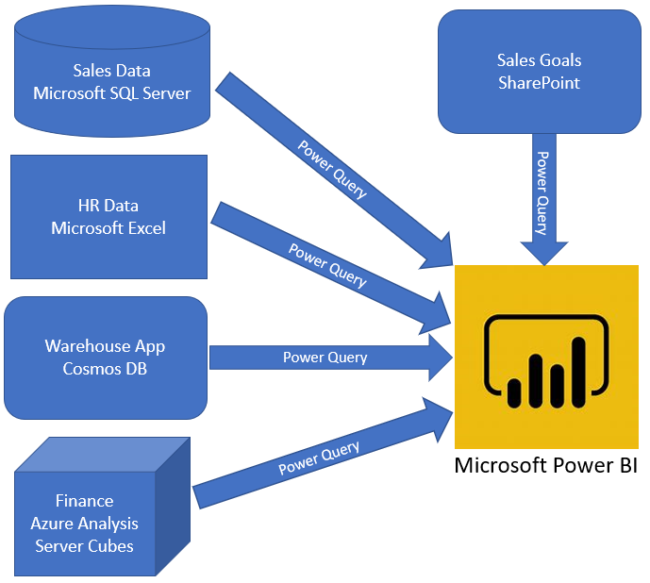
Getting Data
The first step in the data analysis process is identifying and getting data.

Slide 5
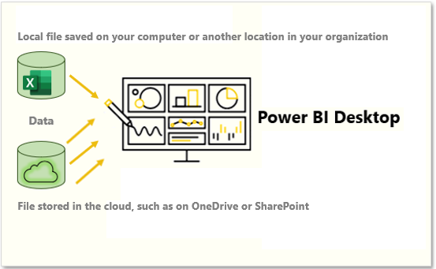

Getting Data From Files
Data from flat files in different formats like
txt
Json
xls /xlsx
are imported in Power BI and becomes part of Power BI.

Slide 6
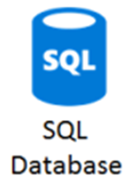



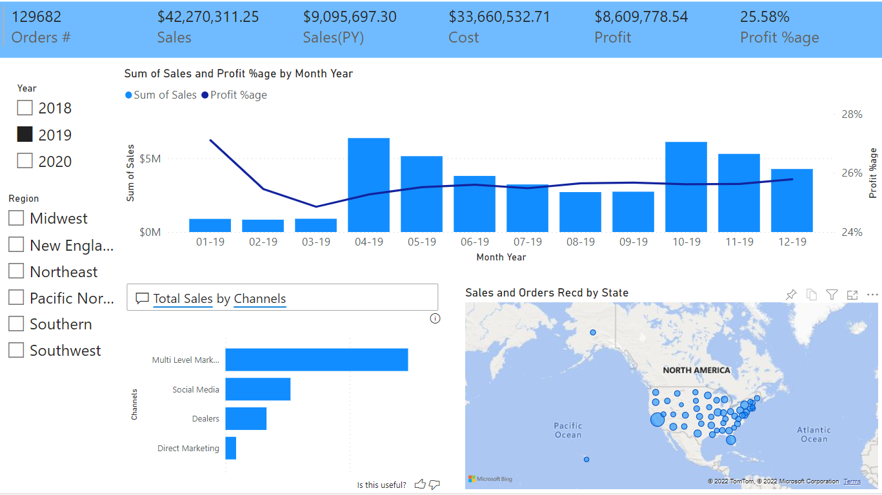
Getting Data From Relational Data Sources
Power BI allows connecting to data sources in
Import mode , where-in data is imported in Power BI.
Direct query mode, where-in live data is fetched when report is run.

Slide 7
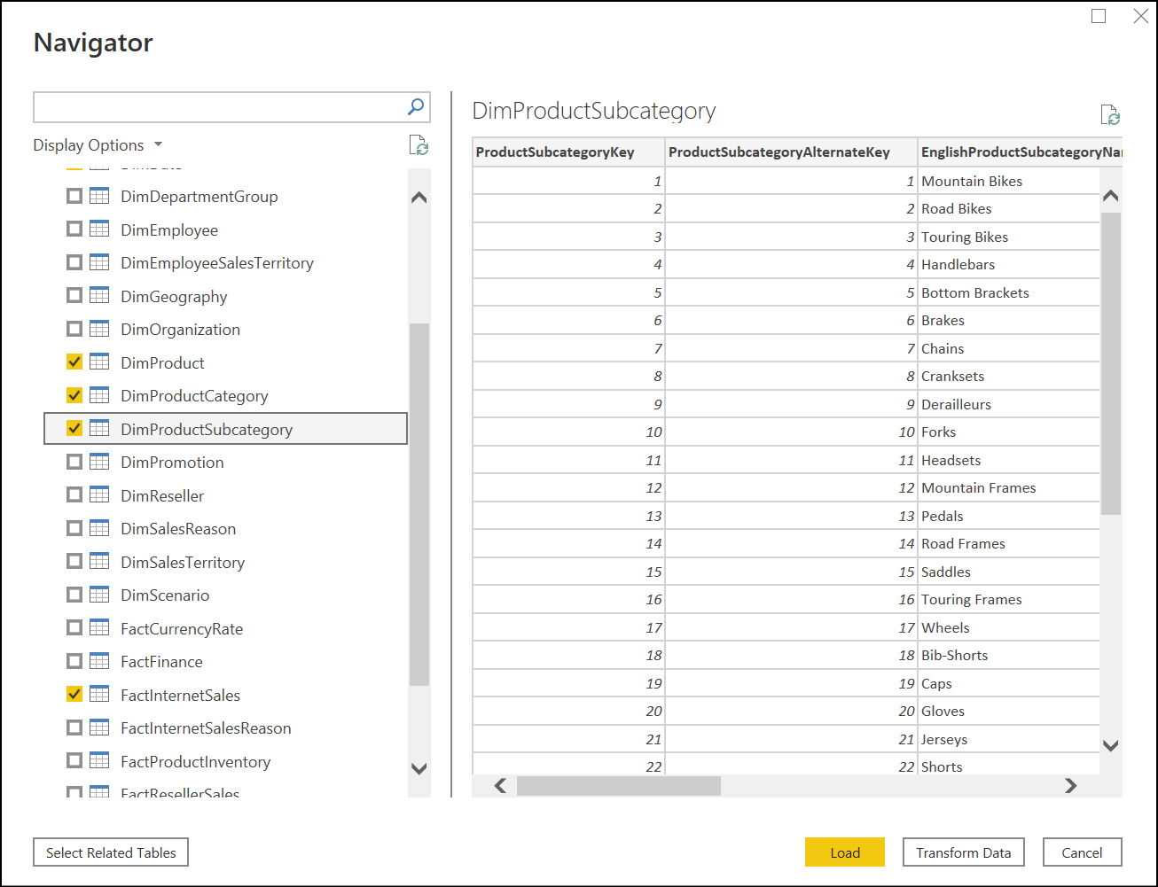
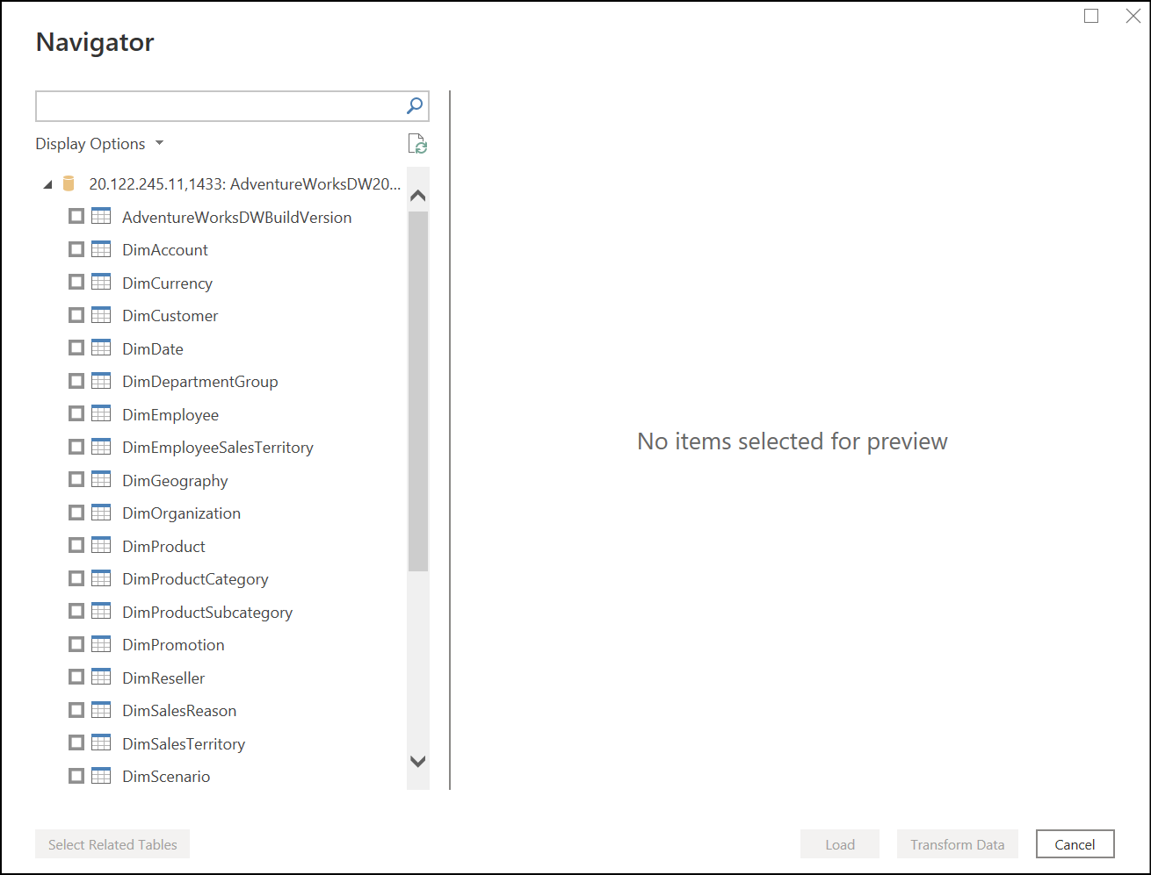
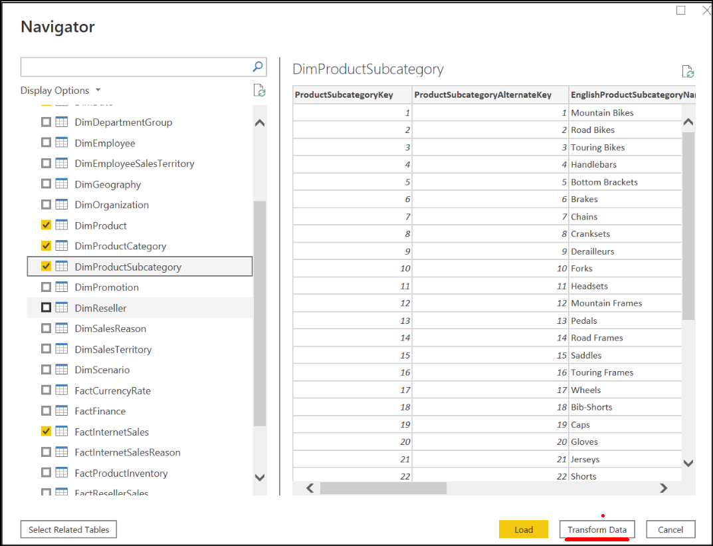
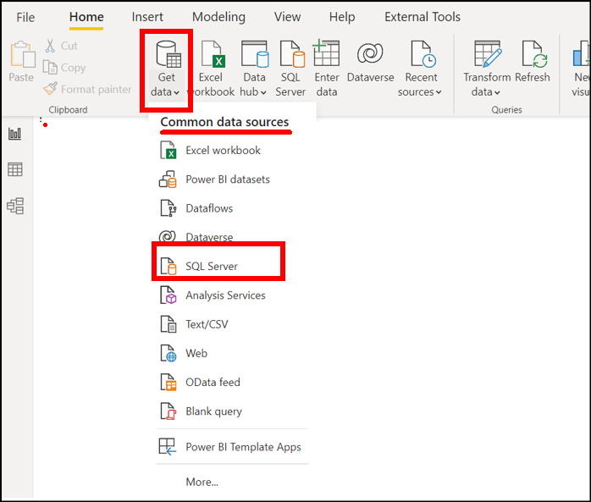
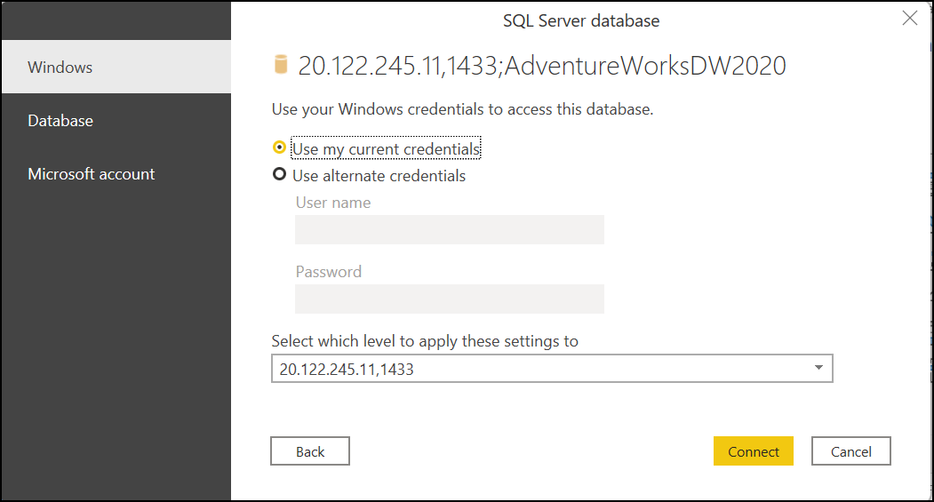
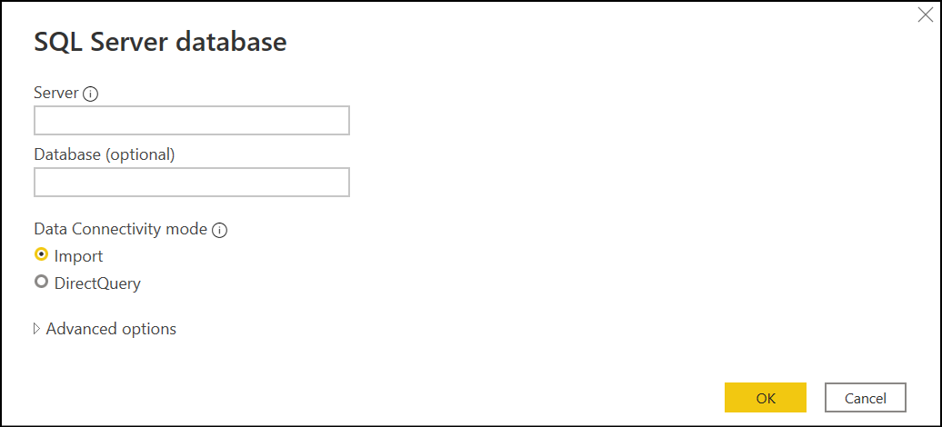
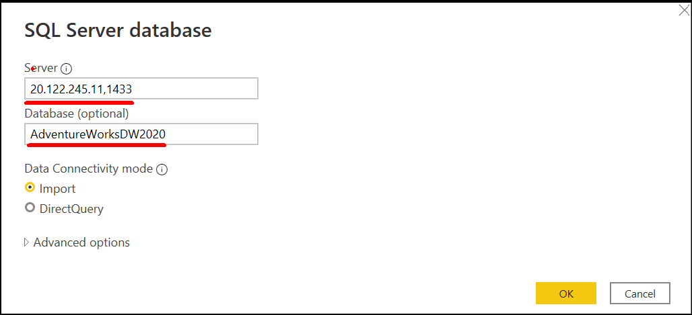
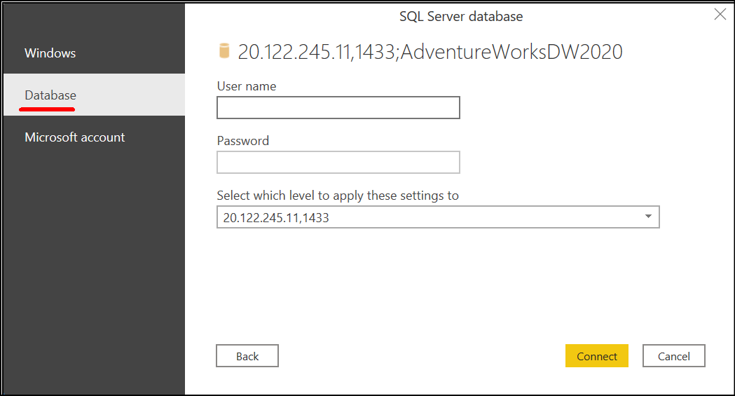

Getting Data in Power BI Desktop
You can use the Get data feature in Power BI Desktop and select the appropriate source.
For this example, you would select the SQL Server option, as shown in the following screenshot.
Select tables /views
Click on Load button to Load the data in Power BI Model
Click on Transform Data to open Power Query Editor

Slide 8
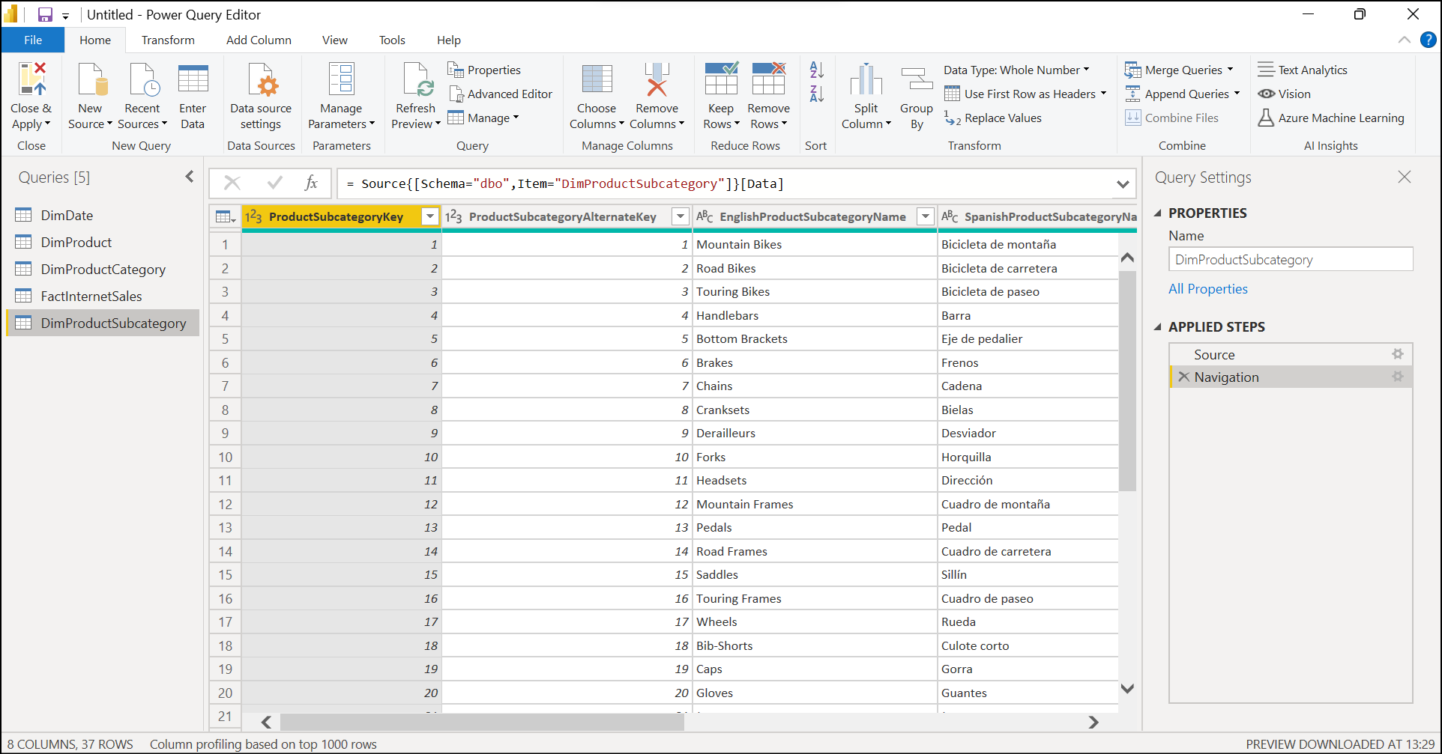
Getting Data in Power BI Desktop
And it will show Power Query Editor window as follows

Slide 9
Shaping Table Structure
Use Power Query Editor to clean up and shape data by
Identifying Column Headers and Names
Rename the queries
Assigning Appropriate Datatypes
Delete unnecessary rows and columns. This will reduce a dataset size thereby will improve the performance

Slide 10
Knowledge Check
Q01 – What is primary data preparation tool in Power BI is called?
A. Power Query Editor B. Query Editor C. Power Editor
A01 – Power Query Editor
Q02 – What can be achieved by removing unnecessary rows and columns?
A02 – Deleting unnecessary rows and columns will reduce a dataset size and its good practice to load only necessary data into your data model.

Slide 11
Lesson 2: Data Profiling

Slide 12
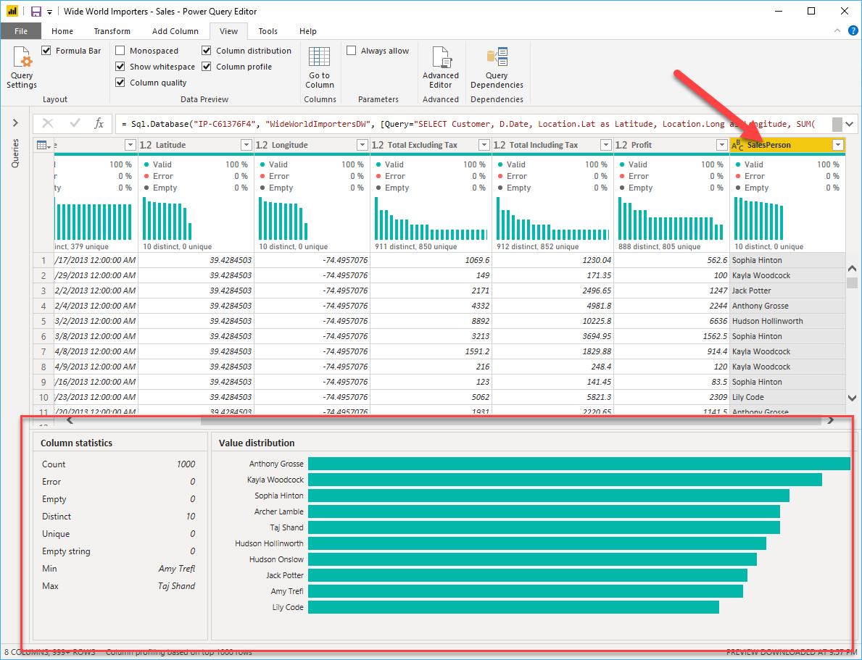
Data Profiling
Data profiling is the process of examining, analyzing, and creating useful summaries of data.
Data profiling helps in
Verifying that the information in your tables matches the descriptions.
Getting helps in discovery of data quality issues and overall trends.

Slide 13
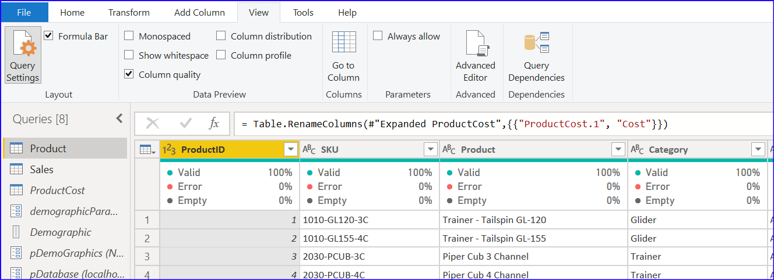
Data Profiling
Column Quality:
The information provided includes the number of Error, Empty, and Valid data cells in that column and their percentage.
There is a simpler way to see this for all columns in the table. You can enable the Column Quality in the View tab in the Power Query Editor

Slide 14
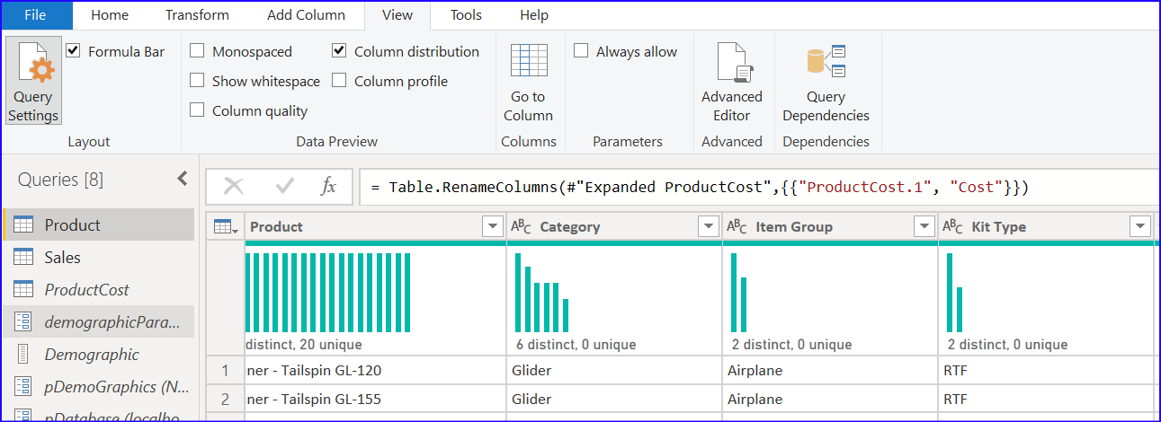
Data Profiling
Column Distribution: How values are spread
Unique vs Distinct
“Distinct” means total number of different values regardless how many times it appears in the dataset. A name appears in the list multiple times is counted as 1 distinct count.
“Unique” value is total number of values that only appear once.

Slide 15
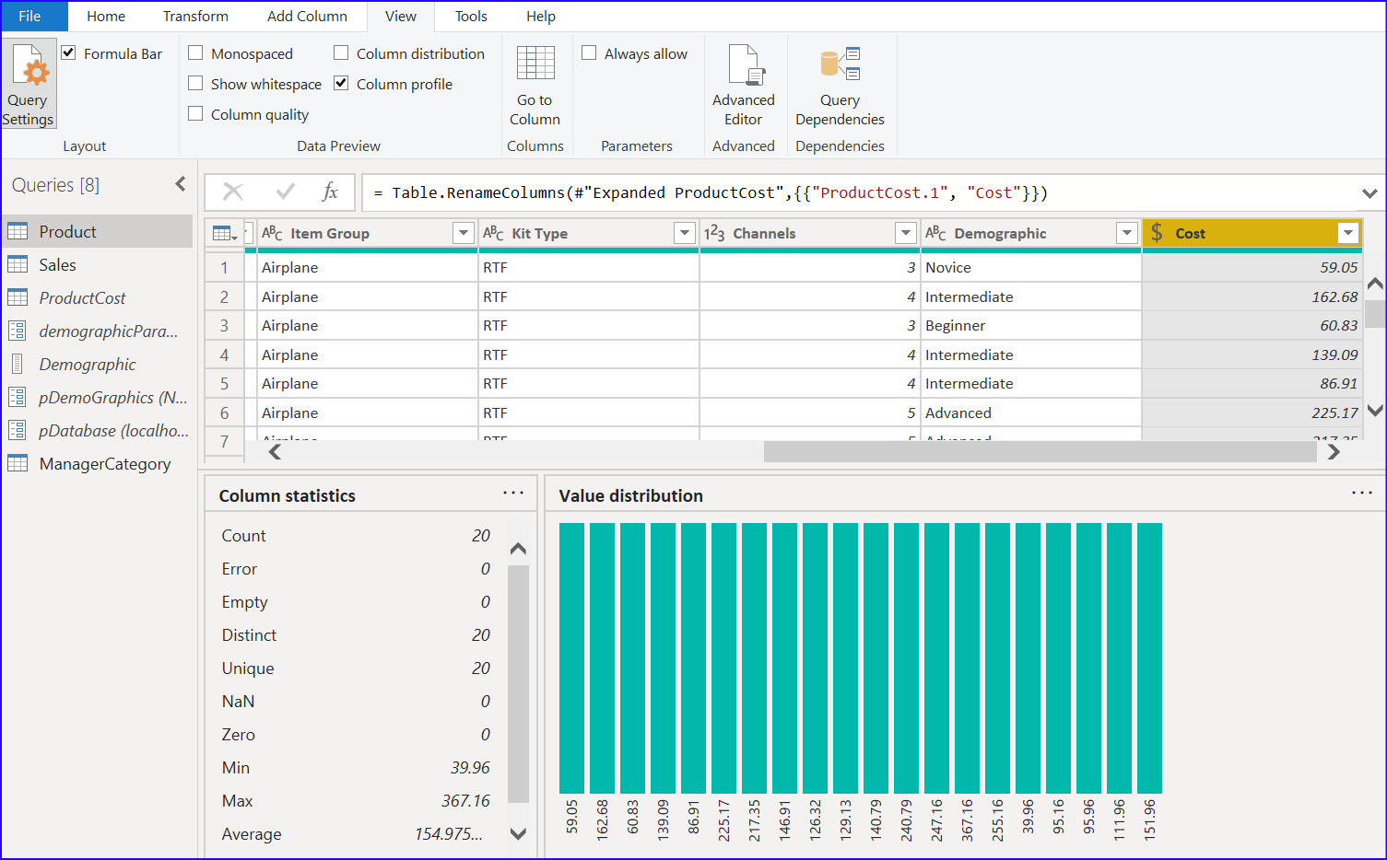
Data Profiling
Column Profile
Column profile provides a much more complete version of the other two options. It
includes the count of errors and empty values
It also includes the distribution of values in the column.
It also includes statistical information such as the minimum, and the maximum values, count of unique values, and the distribution of values in detail.

Slide 16
Knowledge Check
Q01 – How many rows does Power Query by default scans to detect type of data in the column?
A. 1000 B. 999 C. Does not Scan d. As per configuration
A01 - 1000
Q02 – What can be achieved by data profiling?
A02 - Data profiling helps in
Verifying that the information in your tables matches the descriptions.
Getting helps in discovery of data quality issues and overall trends.
Q03 - What is the risk of having null values in a numeric column?
A03 - DAX expressions that AVERAGE data will be incorrect.

Slide 17
Lesson 3: Enhancing Structure

Slide 18
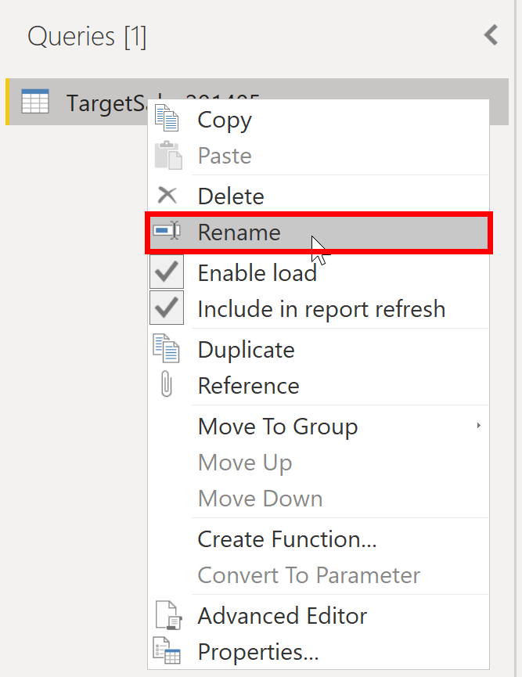
Enhance Structure
Use Power Query Editor to enhance structure by
Renaming existing queries to meaningful names

Slide 19
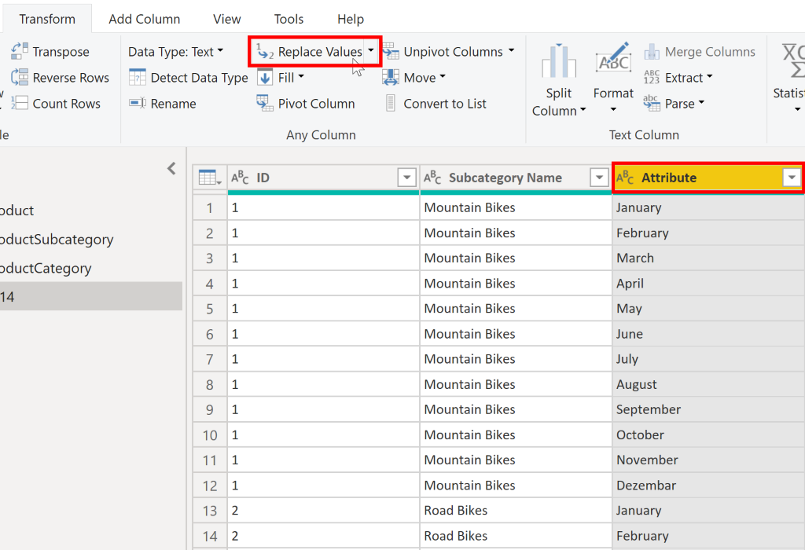
Enhance Structure
Use Power Query Editor to enhance structure by
Replacing any value with another value in a selected column.

Slide 20
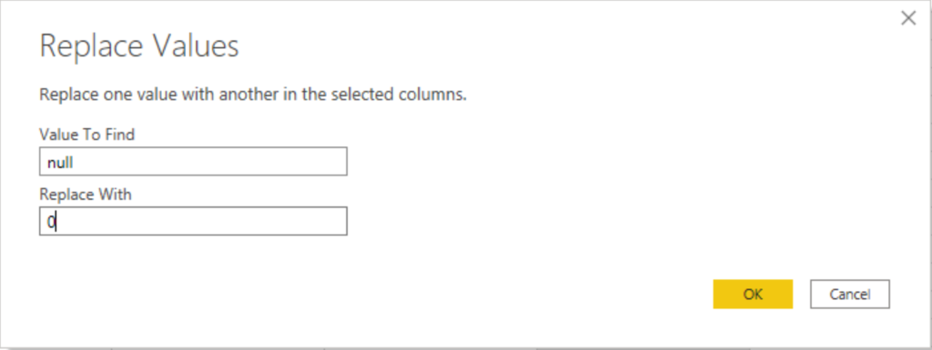
Enhance Structure
Use Power Query Editor to enhance structure by
Replacing null values

Slide 21
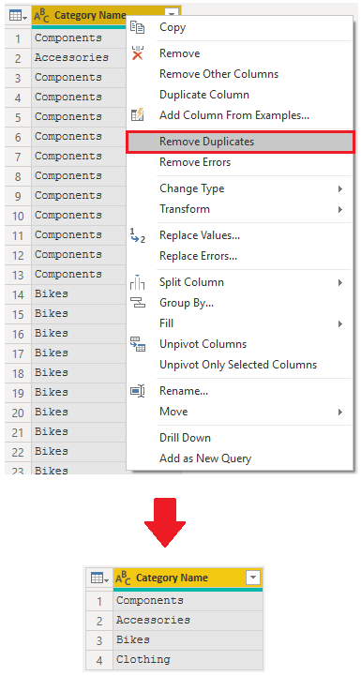
Enhance Structure
Use Power Query Editor to enhance structure by
Removing duplicates

Slide 22
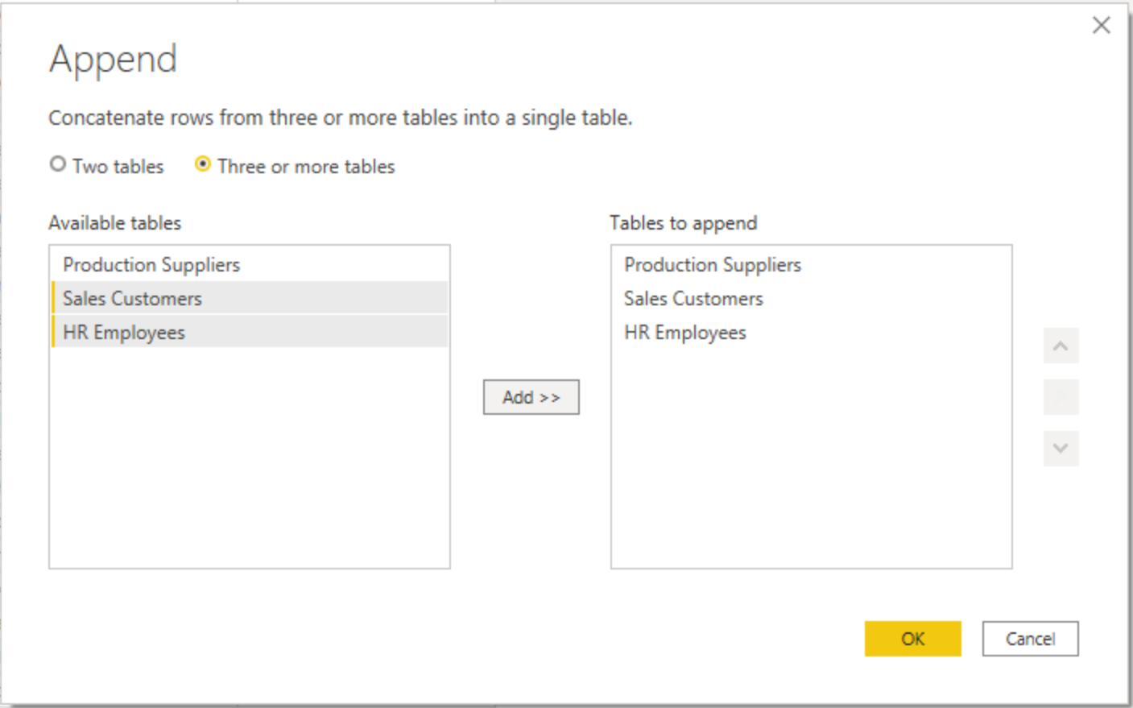
Combining Queries
Append Queries in Power Query Editor allows to append or merge different tables or queries together.
Employee ID | First Name | Last Name | Salary
101 | Peter | Dsouza | 13000
102 | John | Harkings | 10000
103 | Ian | Mayes | 15000
Employee ID | First Name | Last Name | Salary
101 | Peter | Dsouza | 13000
102 | John | Harkings | 10000
103 | Ian | Mayes | 15000
201 | Jan | Burton | 19000
202 | Alan | Chisham | 12000
203 | Suzy | Bae | 18000
Employee ID | First Name | Last Name | Salary
201 | Jan | Burton | 19000
202 | Alan | Chisham | 12000
203 | Suzy | Bae | 18000
Select queries that you want to append

Slide 23
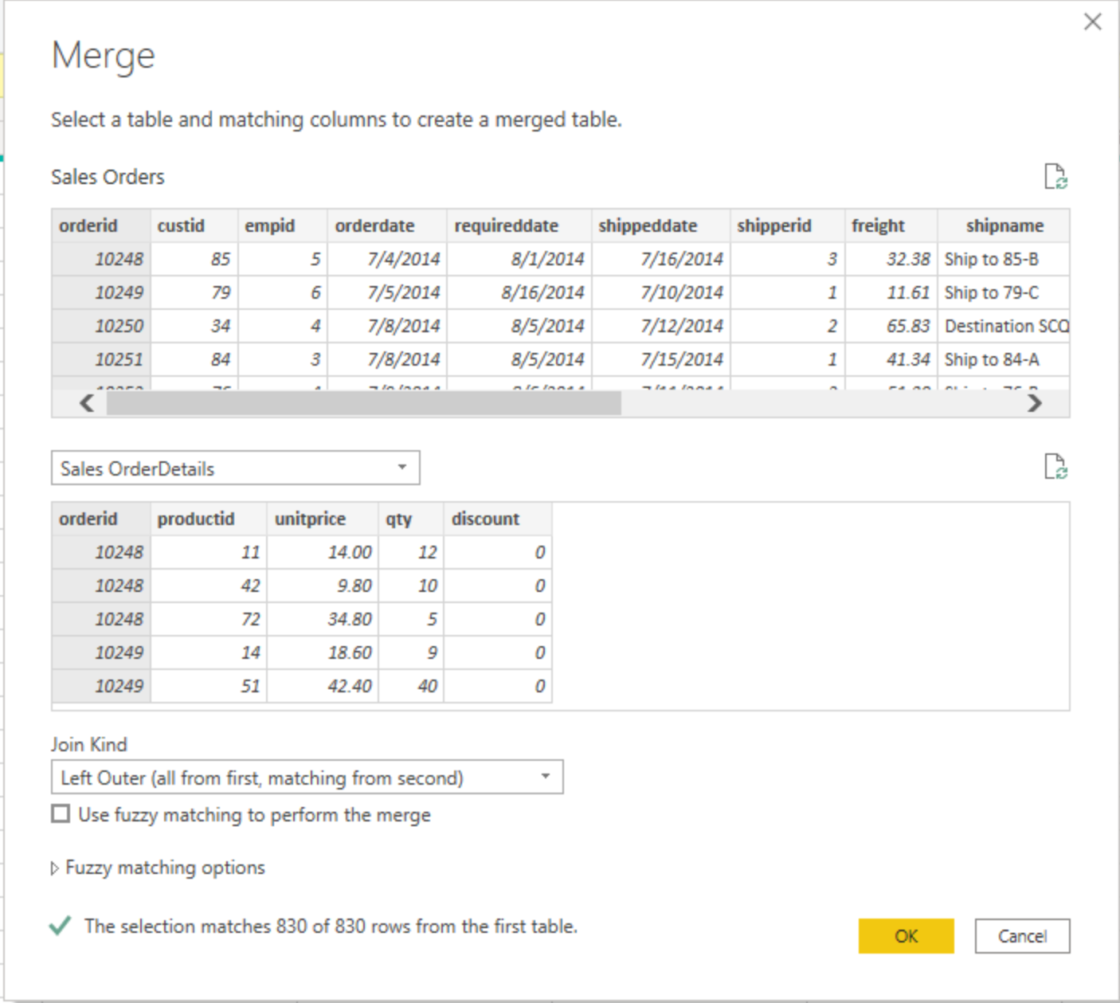
Combining Queries
Merge Query in Power Query Editor combines data from multiple tables into one based on a column that is common between the tables. This process is similar to the JOIN clause in SQL.
Employee ID | First Name | Last Name | Loc ID
101 | Peter | Dsouza | 1
102 | John | Harkings | 1
103 | Ian | Mayes | 3
Location ID | Location
1 | USA
2 | UK
3 | India
Employee ID | First Name | Last Name | Location
101 | Peter | Dsouza | USA
102 | John | Harkings | USA
103 | Ian | Mayes | India

Slide 24
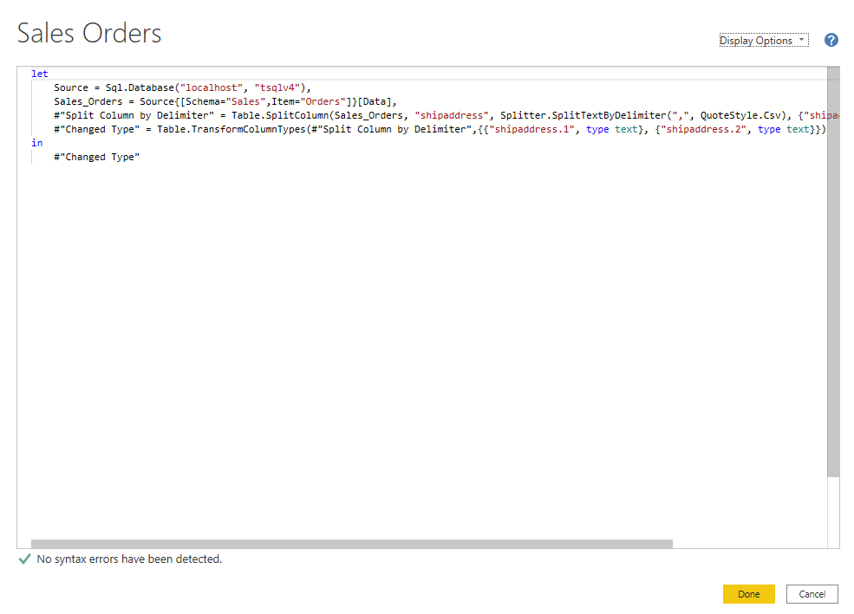
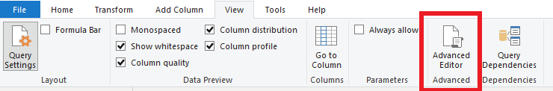
Calculations using M-Language
Each time you shape data in Power Query, you create a step in the Power Query process.
Each step in turn uses the M language to do the operation.
We can see /modify the steps Power Query Editor is creating by using Power Query Advanced Editor.

Slide 25
Knowledge Check
Q01 – What is not a best practice for naming conventions in Power BI?
A. Abbreviated column names B. Abbreviated table names C. Both of the above
A01 - C
Q02 – What functionality lets you see the code that is generated as part of each transformation step?
A. Advanced Editor B. Advanced Transformations C. Advanced Viewer
A02 - A
Q03 – If you have two queries that contain different data with the same structure, and you want to combine them into one query, which operation should you perform?
A. Append B. Merge
A02 - Append

Slide 26
Lab 01: Load data in Power BI Desktop
In this lab, you'll begin to apply transformations to queries. You'll then apply the queries to load each as a table to the data model.
In this lab, you learn how to:
Apply various transformations
Apply queries to load them to the data model

